Slide 1




Course Name
MAD Flutter

Slide 2
This course will teach you, how to develop a mobile app with the help of Dart (Programming Language) + Flutter (Mobile UI Framework).

Slide 3
Introduction
We will Cover
What is Flutter
Why Flutter
Flutter Architecture
Flutter Alternatives
Flutter Versions

Slide 4
What is Flutter?
Flutter is Google’s UI toolkit for building beautiful, natively compiled applications for mobile, web, and desktop from a single codebase.
Flutter in native language is an app SDK by Google which can help you code for Android as well as iOS on a single codebase. It is used for building high-performance apps for Android, iOS, Web and Desktop.

Slide 5
Why Flutter?
One code base to rule them all. You only need to know one programming level Dart, which is very powerful language similar to JavaScript.
A simple and Flexible layout system : Remember one thing before anything, that Everything is a Widget in Flutter.
A widget is a building block for your user interface. Using widgets is like combining Legos. Like Legos, you can mix and match widgets to create something amazing.

Slide 6
Why Flutter? cont. . .
Fast Development
Native Performance : Flutter provides various pre-defined widgets and classes for a full native feel of the app on Android or on iOS.
It provide Fast development by offering hot reload

Slide 7
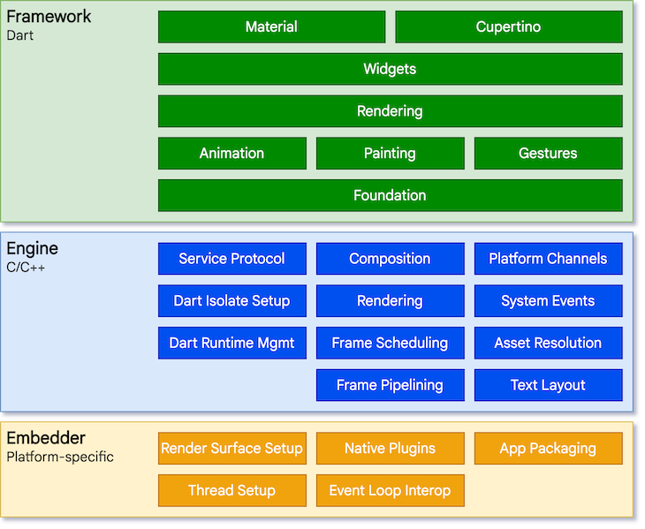
Flutter Architecture

Slide 8
Flutter Architecture
The flutter architecture based on three layered system.
Framework (Dart): where developers interact with Flutter is written in the Dart language. It functions as a sequence of independent libraries, with each of them depending on the underlying layer
Engine (C/C++):The engine layer is written in C/C++, and it takes care of the input, output, network requests, and handles the difficult translation of rendering
Embedder: This layer provided by a platform-specific embedder, which coordinates with the underlying operating system.
Flutter code can be embedded into an existing application as a module or as the complete application’s content using the embedder.

Slide 9
Flutter Alternatives
Flutter vs.
React native vs.
Xamarin

Slide 10
React Native
An open-source UI software framework created by Facebook in 2015.
Used to develop applications for both Android and IOS.
React Framework, a JavaScript library along with native platform is used to develop applications.
Allows developers to use developers to write native code in languages such as Java or Kotlin for Android, Objective-C or Swift for IOS which makes it even more flexible.

Slide 11
Flutter
Released by Google in 2017.
Used to develop applications for both Android and IOS.
Flutter uses Dart language. Dart is a client-optimized language for developing fast apps on any platform.
According to the 2020 Developer Survey, Flutter is much more loved than Xamarin with a staggering 68.8 percent of developers expressing interest in developing applications with Flutter.

Slide 12
Xamarin
Xamarin is a cross-platform mobile app development framework owned by Microsoft based on Mono, a free and open-source .NET framework.
Founded by engineers in 2011 and later acquired by Microsoft in 2016.
Apps are developed using C# language and Microsoft Visual Studio tool is used.

Slide 13
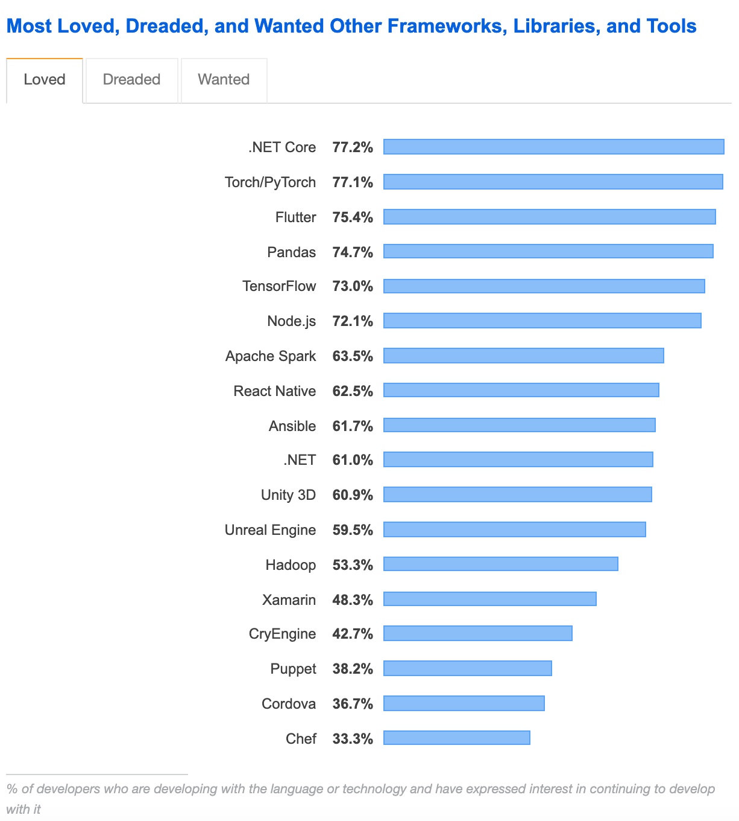
Comparison (React Native VS Flutter)
According to the survey of most loved frameworks on stack overflow in 2020, Flutter was more favored by developers than React Native.

Slide 14
Flutter Version
The first version of Flutter was unveiled at the 2015 Dart developer summit. The first stable release was delivered on the 4 of December 2018 and on May 6, 2020, the Dart SDK version 2.18 and Flutter version 1.17 were released delivering a build with Material API integration.
Currently, Flutter 2.10 is here

Slide 15

Thank
You !

